Slide 1

CSA15 | Cloud Computing and Big Data Analytics
CSA1517 Cloud Computing and Big Data Analytics
Presenter Details
Student Name: Krishna Gupta
Register Number: 192524062
Class / Section / Slot: C
Capstone Title: FoodTrace Cloud Supply Chain Tracker
Selected SDG Goal(s): SDG 2, SDG 9, SDG 12
Cloud Platform / Tools: Cloud Run, Firebase, PostgreSQL, FastAPI, React, Flutter, QR Library
FoodTrace: Cloud Supply Chain Tracker
With QR Provenance and Spoilage Prediction
Presentation Focus
FoodTrace uses Google Cloud Run, Firebase, PostgreSQL, Python FastAPI, React, and Flutter to track food batches from farm to consumer with QR-based provenance and spoilage prediction.
Individual student submission template | Department of Computer Science and Engineering
CO1 AT3 | 01
Notes:
Open by naming the capstone problem and the cloud product objective. Keep the title slide uncluttered and clearly identify the individual presenter.

Slide 2
CSA15 | Cloud Computing and Big Data Analytics
Problem Context and Stakeholder Mapping
Our capstone begins with a real problem to solve
Problem Statement
Target Users
Food products move through many suppliers and warehouses without recorded origin or storage history, increasing spoilage and reducing consumer trust.
Farmers, manufacturers, warehouse managers, transport companies, retailers, food safety authorities, and consumers gain real-time batch visibility.
SDG Fit
Product Boundary
SDG 2 improves food availability by reducing spoilage, SDG 9 modernizes supply chains with cloud technology, and SDG 12 encourages responsible production.
Batch registration, QR generation, movement tracking, storage monitoring, spoilage prediction, recall workflow, and an analytics dashboard.
Individual student submission template | Department of Computer Science and Engineering
CO1 AT3 | 02
Notes:
Do not start with technology. First make the need clear, then connect it to cloud-enabled scale, reach, or reliability.

Slide 3
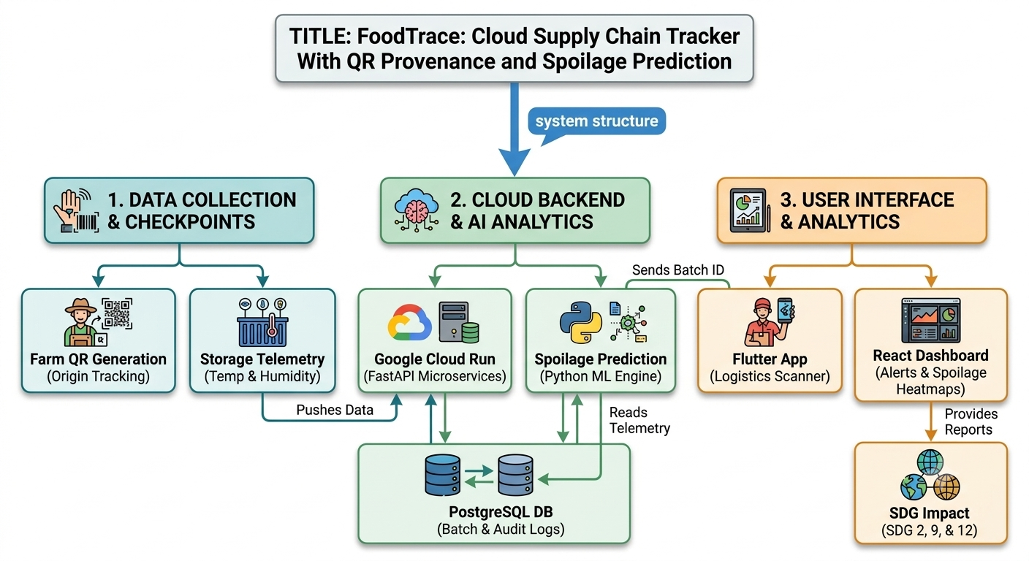
CSA15 | Cloud Computing and Big Data Analytics
Cloud Adoption Rationale and Concept Map
The problem needs cloud support to become a usable product
Cloud Definition
Cloud Concept Map
FoodTrace uses cloud computing to securely store, process, and share supply chain data, enabling real-time tracking for all stakeholders.
Cloud Characteristics
Elastic Scalability
Resource Pooling
On-demand Access
Measured Service
Individual student submission template | Department of Computer Science and Engineering
CO1 AT3 | 03
Notes:
Students should explain the concept map as a reasoning artifact, not as decoration.

Slide 4
CSA15 | Cloud Computing and Big Data Analytics
Capstone Cloud Architecture
Our cloud architecture connects the user action to services
Scaling point
Firebase Authentication
REST API Gateway
Python FastAPI
QR Verification Service
Spoilage Prediction Engine
PostgreSQL Database
Cloud Object Storage
React Web + Flutter Scanner
Security boundary
Presentation Points
User Request Flow
REST APIs
Compute Services
Database
Storage
Monitoring
Security
Dashboard
Cloud Monitoring
Audit Logs
Individual student submission template | Department of Computer Science and Engineering
CO1 AT3 | 04
Notes:
Walk from user request to API, compute, data, storage, analytics, monitoring, and security boundary.

Slide 5
CSA15 | Cloud Computing and Big Data Analytics
Cloud Service Model Responsibility Matrix
Each service model defines what we control and what cloud manages
Service area
Model
Provider manages
Student team manages
Why this fits
SaaS
Hosting Platform
UI Development
Fast Deployment
Frontend Hosting
PaaS
Runtime Environment
Business Logic
Auto Scaling
Backend APIs
DBaaS
Database Server
Data Model
Reliable Storage
Database
SaaS
File Storage
Certificates
Secure Storage
Object Storage
SaaS
Cloud Logs
Dashboard
Performance Analysis
Monitoring
SaaS
Authentication
User Roles
Secure Access
Security
Individual student submission template | Department of Computer Science and Engineering
CO1 AT3 | 05
Notes:
Ask the student to defend provider responsibility and student responsibility for the selected service models.

Slide 6
CSA15 | Cloud Computing and Big Data Analytics
Data Flow and Analytics Pipeline
The product data moves from user activity to useful insight
QR Scan
Temperature
Batch Details
PostgreSQL
Cloud Storage
Risk Prediction
Analytics
Dashboard
Reports
Alerts
REST API
Data Requirements
Analytics Requirement
Proof Required
Batch ID, QR ID, temperature, humidity, warehouse, timestamp, and transport details.
Spoilage Prediction
Supply Chain Performance
Food Waste Analysis
QR Scan Demo
Spoilage Report
Dashboard Screenshot
Individual student submission template | Department of Computer Science and Engineering
CO1 AT3 | 06
Notes:
Big data analytics is optional, but a thoughtful data path is expected.

Slide 7
CSA15 | Cloud Computing and Big Data Analytics
Python / AI Module Integration
Python or AI adds intelligence where the product needs it
Python Role
Input and Output
Predicts spoilage risk using storage conditions and shelf-life analytics.
Input: Temperature, Humidity, Transit Time
Output: Risk Score, Freshness Status, Alert
Execution Point
Product Value
Python FastAPI
Cloud Run
Secure REST Endpoint
Detect spoilage early
Reduce food waste
Improve consumer safety
Faster recall decisions
Individual student submission template | Department of Computer Science and Engineering
CO1 AT3 | 07
Notes:
If AI is not required, students can present a Python automation or analytics module instead.

Slide 8
CSA15 | Cloud Computing and Big Data Analytics
Security, Scalability, Privacy and Cost Design
Security, scale, privacy and cost shape the final design
Security
Privacy
Firebase Authentication
Role-Based Access Control
HTTPS Communication
Audit Logging
Encrypted Cloud Storage
Authorized User Access
Secure Batch Data
Limited Data Visibility
Scalability
Cost Awareness
Cloud Run Auto Scaling
Scalable PostgreSQL & Storage
Firebase Free Tier
Pay-as-you-go Cloud Run
Low-Cost Object Storage
Efficient API Usage
Individual student submission template | Department of Computer Science and Engineering
CO1 AT3 | 08
Notes:
This slide is where students show engineering judgment instead of simply listing services.

Slide 9
CSA15 | Cloud Computing and Big Data Analytics
Implementation Stack and Deployment Evidence
Our implementation stack shows how the design will be built
Mobile / Web Layer
Cloud Services
React.js
Flutter
Responsive Web Interface
Cloud Run
Firebase Authentication
PostgreSQL
Cloud Storage
Evidence
Version Control
GitHub repository, API testing, QR scan demo, dashboard, deployment URL, and cloud logs.
Git Repository
Feature Branches
Commit History
Project README
Individual student submission template | Department of Computer Science and Engineering
CO1 AT3 | 09
Notes:
Evidence should be specific and inspectable, not a generic list of tools.

Slide 10
CSA15 | Cloud Computing and Big Data Analytics
Demo Storyboard and User Journey
A complete user journey proves the product flow
Scene 1
Scene 2
Scene 3
Register Food Batch → Generate QR
Warehouse Scan → Location Updated
Upload Storage Conditions → Database Updated
Scene 4
Scene 5
Scene 6
Run Risk Prediction → Risk Score Generated
Spoilage Alert → Recall Triggered
Dashboard Displays Reports → Analytics Updated
Individual student submission template | Department of Computer Science and Engineering
CO1 AT3 | 10
Notes:
A storyboard helps the faculty see whether the cloud architecture is connected to actual use.

Slide 11
CSA15 | Cloud Computing and Big Data Analytics
Evaluation Readiness Checklist
Our evidence confirms that the presentation is ready
Cloud ecosystem and service model explained
Elasticity and scalability decisions are visible
REST/SOAP/API role connected to capstone
GitHub and cloud evidence are inspectable
Architecture has compute, data, storage, security, monitoring
References and integrity statement are included
Evaluator Focus
CO1 is verified through cloud design reasoning, service choices, evidence, and individual explanation.
Individual student submission template | Department of Computer Science and Engineering
CO1 AT3 | 11
Notes:
Students can use this as the self-check slide before presenting the conclusion.

Slide 12
CSA15 | Cloud Computing and Big Data Analytics
Conclusion, Limitations and Future Scope
We close with learning, limitations and next steps
Learning Outcome
Limitations
Learned cloud architecture
Built QR traceability
Applied cloud analytics
Implemented REST APIs
Limited IoT sensor integration
Internet connectivity required
Rule-based prediction only
Future Improvement
Integrity Statement
IoT Sensors
AI-Based Prediction
Blockchain Traceability
Mobile Notifications
Developed for academic purposes using Google Cloud, Firebase, PostgreSQL, Python FastAPI, React.js, Flutter, and QR libraries. Public documentation and AI-assisted tools were used only for research and presentation preparation.
Individual student submission template | Department of Computer Science and Engineering
CO1 AT3 | 12
Notes:
The ending should synthesize learning, not just say thank you.

